Slide 1
Opto Electronics
Lecturer # 04
Fiber Loses

Slide 2
Lecturer objective
Basic causes of fiber energy loss and dispersion
Fiber energy loss and dispersion, effect on optical communication performance
Reason, some wavelengths are preferred over other

Slide 3
Attenuation /fiber Loss
Determine, Repeater less separation between
sender and receiver and System cost
Loss=pout/pin
In Decibels
Loss=10log(pout/pin)

Slide 4
Fiber Losses
Material Loses
Intrinsic Absorption/Atomic structure of material itself
Extrinsic Absorption/Due to metal impurity i.e. Cr, Cu, OH ions

Slide 5
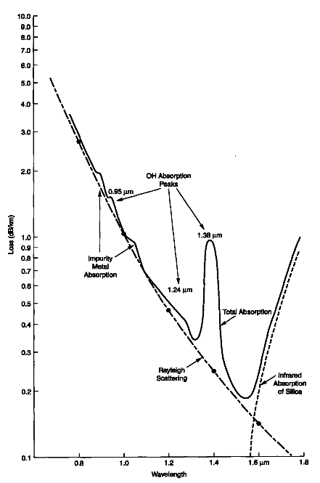

Slide 6
Fiber Losses
Scattering Losses
Related to Fiber material and mechanical
Imperfections/
Light scattered by abstraction/density variation

Slide 7
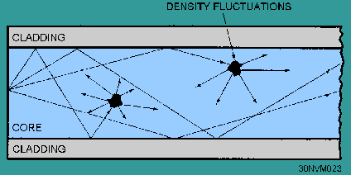
Scattering Losses

Slide 8
Types of Scattering
Rayleigh scattering/ when obstraction size< wavelength
Mie scattering/ when obstraction size> wavelength

Slide 9
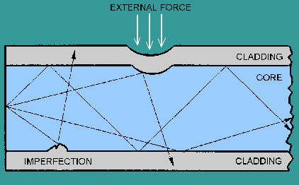
Waveguide/microbend loss

Slide 10
Dispersion
Pulse broadening effect

Slide 11
Intermodal dispersion
It is a dispersion b/w two modes caused by the difference in propagation time for different modes

Slide 12
Intermodal dispersion
A train of light pluses is transmitted through a 400-m fiber with ncore=1.4 and nclad=1.36.
a) sketch the output pulse for
10Mb/s data rate
20Mb/s data rate
b) find Dispersion per Km
Assume that input pulse is of near-zero with
dispersion=52.6 ns

Slide 13
Conclusion
400-m fiber cannot be used at 20Mb/s data rate
without special reshaping of pulses after
approximately 200m.
Larger acceptance angle, make it easy to inject
power into a fiber but cause dispersion.

Slide 14
Interamodal Dispersion
Light in fiber consists of group of frequencies
Interamodal Dispersion related to line with
Interamodal Dispersion , in single mode and multi mode fiber
Minimum intermodal dispersion wavelength is about 1300nm

Slide 15
Choice of wavelength
For better performance, choice of wavelength must be based on minimizing loss and Dispersion

Slide 16
Choice of wavelength
First Window(820nm-880nm)
Second Window(1200nm-1320)
Third Window(1550nm-1610nm)

Slide 17
Choice of wavelength

Slide 18
Choice of Optical Fiber
Multimode Step index(intermodal dispersion+ interamodal dispersion)
For short distance only
Less length bandwidth product
Single mode Step index(interamodal dispersion)
Lowest loss highest data rate fiber
Multimode graded index(less intermodal dispersion+ Interamodal dispersion)

Slide 19
Dispersion shifted fibers
Constructed so the minimum dispersion shifted towards 1550nm-1610nm

